Slide 1
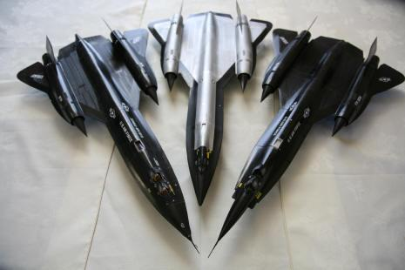
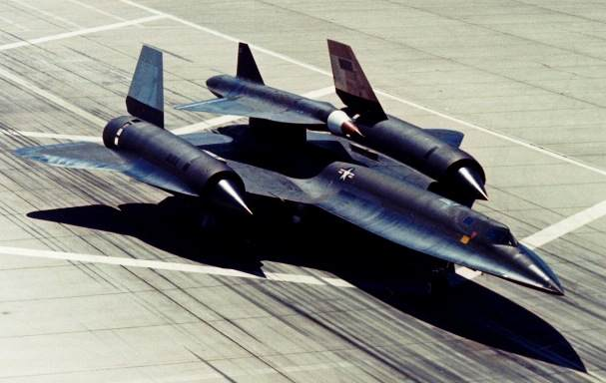

Slide 2
OPER 610 Lesson 02 Geometry of LPs: Feasible Regions, Contours, Optimality
Dr Brian J. Lunday
Office: Rm 201E, Bldg 641

Slide 3
Geometric Solution (1 of 5)
1
2
3
4
feasible
region

Slide 4
Common Software for LP
Algebraic Modeling Languages (AMLs)
GAMS
LINGO IDE
IBM’s Optimization Programming Language (OPL)
AMPL
MPS
Generalized Programming Languages (GPLs)
C++
Java
.NET
Python
MATLAB
Problem Formulation
Objectives
Restrictions, Limitations, and Constraints
Within DoD planning, it’s “limitations = constraints + restrictions”
Model Creation
Formulate the math program
Granularity vs. tractability
Assumptions and more assumptions!
Algebraic formulation
Sets, parameters, decision variables
Objective function(s), constraints, decision variable bounds
Verification, Validation, & Refinement (VV&R)
Non-AML model & solve options
(typically more limiting)
Excel (Solver)
Mathematica (Minimize)
MATLAB (linprog)
Python (SciPy, others)
R (lpSolve)
------------------------------------
Julia (JuliaOpt)
SAS (LPSOLVE)
Testing, Analysis, Restructuring
Iterative implementation
Granularity vs. tractability
Robustness to parametric variations
Commercial Solvers
BDMLP
CLP
CPLEX
FICO-Xpress
Gurobi
MOSEK
And many more…
Implement the Solution
Prescriptive analytics vs. “Recommendive” analytics
If the problem isn’t static, will the solution be?
Solve the MP Instance
Problem vs. math program vs. instance
What does a “solution” entail?
Algorithm vs. heuristic vs. metaheuristic

Slide 5
Geometric Solution (2 of 5)
Optimal Solution
What is ‘c’?
What can you conclude about an optimal solution?
What if it was a minimization problem?

Slide 6
Geometric Solution (3 of 5)
Alternative Optimal Solutions
What can you conclude about an optimal solution?

Slide 7

Geometric Solution (4 of 5)
What can you conclude about an optimal solution?

Slide 8
Geometric Solution (5 of 5)
1
2
3
4
What can you conclude about an optimal solution?

Slide 9
Feasible Solution in Requirement Space Standard Form (1 of 2)
What can you conclude about a feasible solution?
Generated cone
1
2
3
4
5

Slide 10
Feasible Solution in Requirement Space Standard Form (2 of 2)
What can you conclude about a feasible solution?
Generated cone
1
2
3
4
5

Slide 11
Feasible Solution in Requirement Space Canonical Form (1 of 2)
What can you conclude about a feasible solution?
Generated cone
1
2
3

Slide 12
Feasible Solution in Requirement Space Canonical Form (2 of 2)
What can you conclude about a feasible solution?
Generated cone
1
2
3

Slide 13
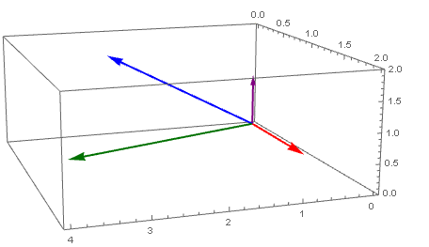
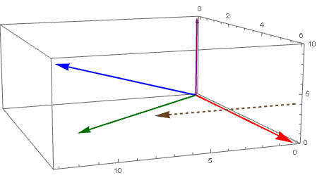
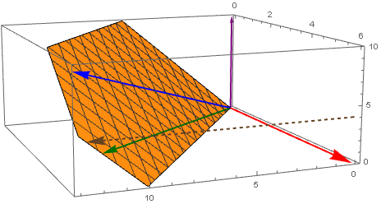
Optimal Solution in Requirement Space Standard Form (2 constraints)
Spanning Vectors
1
2
3
4
5
RHS Vector
(Maximize ‘z’)
z*=12.67

Slide 14
Questions & Discussion

Slide 15
For next class
Sections 2.1-2.3: Linear Algebra Review
Pay extra attention to…
Linear & affine combinations & subspaces
Basis
Replacing a vector in the basis by another
Section 2.4-2.6: Ties OPER 510 and MATH 521 together
Section 2.7: Up to “Representation Theorem” (pg 77) and an understanding of Figure 2.19 (pg 78)
Homework #2: Problems 1.31, 1.41, 1.42
For problems 1.41 & 1.42
Think before you write
Consider possible assumptions about the initial, unperturbed LP

